Slide 1
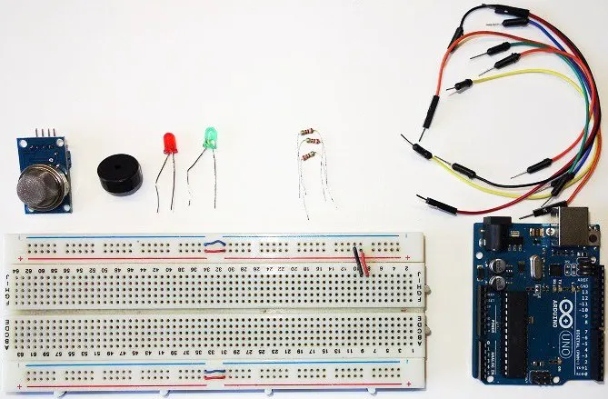
ARDUINO GAS SENSOR PROJECT
Materials ;

Slide 2
CODES FOR THİS PROJECT
int redLed = 12;
int greenLed = 11;
int buzzer = 10;
int smokeA0 = A5;
// Your threshold value
int sensorThres = 100;
void setup() {
pinMode(redLed, OUTPUT);
pinMode(greenLed, OUTPUT);
pinMode(buzzer, OUTPUT);
pinMode(smokeA0, INPUT);
Serial.begin(9600);
}
void loop() {
int analogSensor = analogRead(smokeA0);
Serial.print("Pin A0: ");
Serial.println(analogSensor);
// Checks if it has reached the threshold value
if (analogSensor > sensorThres)
{
digitalWrite(redLed, HIGH);
digitalWrite(greenLed, LOW);
tone(buzzer,1000,200);
}
else
{
digitalWrite(redLed, LOW);
digitalWrite(greenLed, HIGH);
noTone(buzzer);
}
delay(100);
}

Slide 3
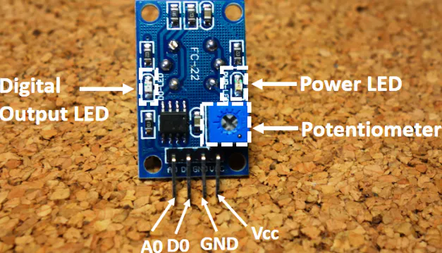
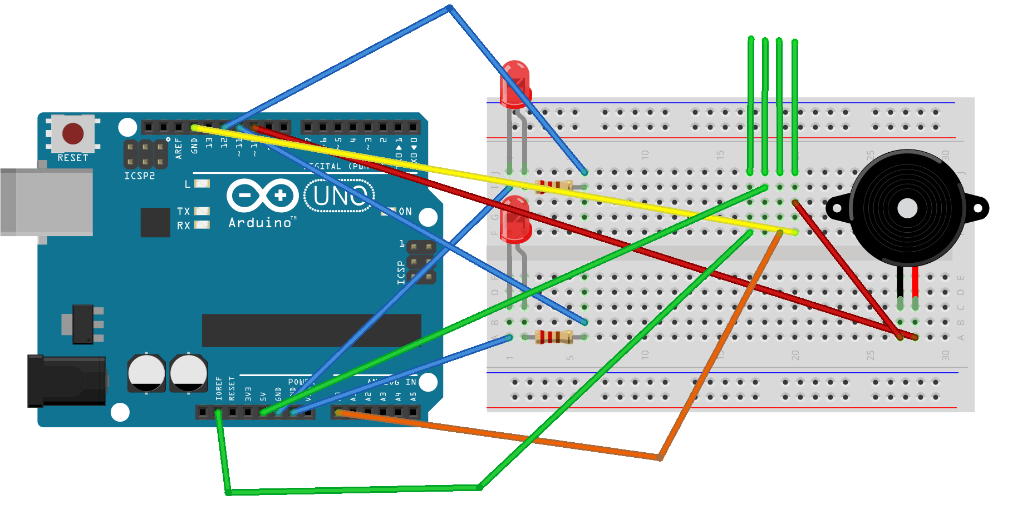
Schematic

Slide 4
Thanks to this project, we are able to measure smoke and some flammable gases like LPG, Butane, Propane, Methane, Alcohol and Hydrogen by using MQ-2 sensor.
How does it Work?
The voltage that the sensor outputs changes accordingly to the smoke/gas level that exists in the atmosphere. The sensor outputs a voltage that is proportional to the concentration of smoke/gas.
In other words, the relationship between voltage and gas concentration is the following:
The greater the gas concentration, the greater the output voltage
The lower the gas concentration, the lower the output voltage

Slide 5
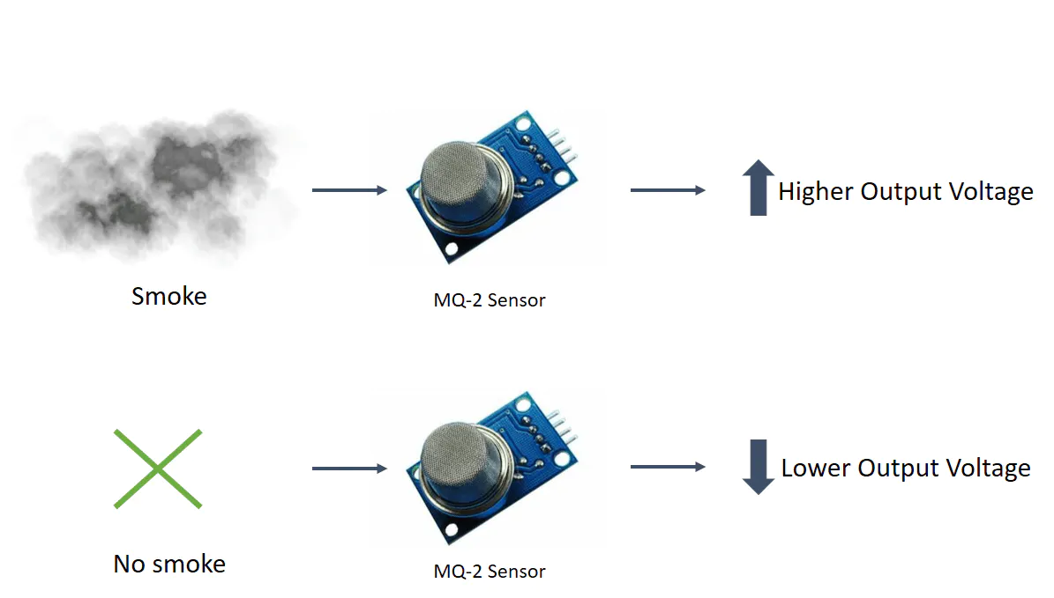

Slide 6

THANK YOU GUYS FOR LISTENING TO US
BATUHAN KARAÇALI
ASSEM ZAKİ

